Slide 1


Data Science & Machine Learning
Customer Attrition Classifier
In Telecommunication Company
Classification Model
Jakarta, June 2020

Slide 2
CONTENT
RESEARCH BACKGROUND
RESEARCH OBJECTIVES
RESEARCH FRAMEWORK

Slide 3
Research Background
Customer Attrition / Customer Churn in Telecommunication Company
Key Factors: required data for Customer Attrition/Churn
Customer Attrition is one of the most important and challenging problems for businesses such as Credit Card companies, cable service providers, SASS and telecommunication companies worldwide. Customer churn metrics can help businesses improve customer retention.
Consider the following facts from a research conducted by Bain & Company:
The cost of acquiring a new customer can be higher than that of retaining a customer by as much as 700%.
Increasing customer retention rates by a mere 5% could increase profits by 25% to 95%.
Types of Customer Attrition:
Volunteer: When customers want to quit the contract and move to the next service provider.
Non-Volunteer: When the company quit the service to a customer.
Silent Churn: Those customers who discontinued the contract without prior knowledge of both parties (customer-company).
Macroeconomic
Transactional Data
Interest rates
Unemployment rates
etc
Demographics
Spend across categories
Purchase frequency
Customer Information
Personal Information
Customer
360
Product Attributes
Pricing
Product specification
Features
etc
Rates and prices
Promotional bundles
etc
Loyalty Program
Marketing
Reward accumulation
Redemption
Customer Service
Campaigns and offers
Response history
Call service history
Online service history
source: Bain & Company

Slide 4

Research Background
Customer Attrition / Customer Churn in Telecommunication Company
Telco Customer Churn from IBM sample dataset : https://www.kaggle.com/blastchar/telco-customer-churn
The data set represents a customer, each column contains customer’s attributes described on the column Metadata:
Customers who left within the last month – the column is called Churn
Services that each customer has signed up for – phone, multiple lines, internet, online security, online backup, device protection, tech support, and streaming TV and movies
Customer account information – how long they’ve been a customer, contract, payment method, paperless billing, monthly charges, and total charges
Demographic info about customers – gender, age range, and if they have partners and dependents
Demographics
Services
Services
Transactional Data
Gender: Female or Male
Senior Citizen: Yes or No
Partner: Yes or No
Dependents: Yes or No
Phone Service: Yes or No
Multiple Lines: Yes, No, No Phone Service
Internet Service: DSL, Fiber Optic or No
Online Backup: Yes, No, or, No Internet Service
Device Protection: Yes, No, or No Internet Service
Tech Suport: Yes, No, or No Internet Service
Streaming TV: Yes, No, or No Internet Service
Streaming Movies: Yes, No, or No Internet Service
Tenure: Number of months
Contract: Monthly, One Year, Two Year
Paperless Billing: Yes or No
Payment Method: Electronic check, Mailed check, Bank transfer, Credit card
Monthly Charges: The amount charged to customer monthly
Total Charges: The total amount charged to customer

Slide 5
CONTENT
RESEARCH BACKGROUND
RESEARCH OBJECTIVES
RESEARCH FRAMEWORK

Slide 6
Research Objectives
Three main purpose of research
1
Exploratory Data of Telecommunication’s Customer Churn to understand better the customer behavior and segmentation.
2
Improving company’s customer 360 view based on relationship of each variable independents toward to customer attrition to retain existing customers.
3
Build Machine Learning Classification Model to predict new user tends to stay within the company’s service or not.

Slide 7
CONTENT
RESEARCH BACKGROUND
RESEARCH OBJECTIVES
RESEARCH FRAMEWORK

Slide 8
Research Framework
Project Scopes:
DATA MANIPULATION
EXPLORATORY DATA ANALYSIS
MACHINE LEARNING MODEL
Distribution visualization of Categorical / Nominal Variables
Correlation visualization of Categorical / Nominal Variables
Finding outliers of Numerical Variables
Data Visualization of range data of Numerical Variables
Correlation visualization of Numerical Variables
Distribution visualization of Numerical Variables
Data Preprocessing for categorical variables
Data Preprocessing for numerical variables
Data Preprocessing for variable dependent
Build Classification Model
Cross Validation for each model
Classification Evaluation Metrics
Confusion Metrics
ROC AUC Metrics
Hyper Parameter Tuning
Cleaning Data
Replacing Data
Separating Data

Slide 9
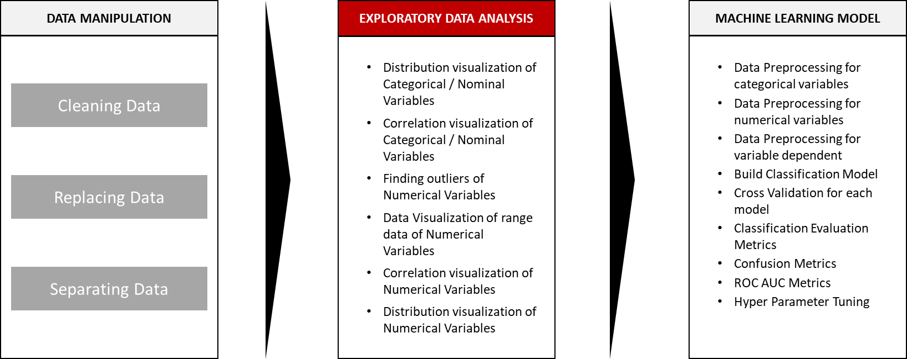
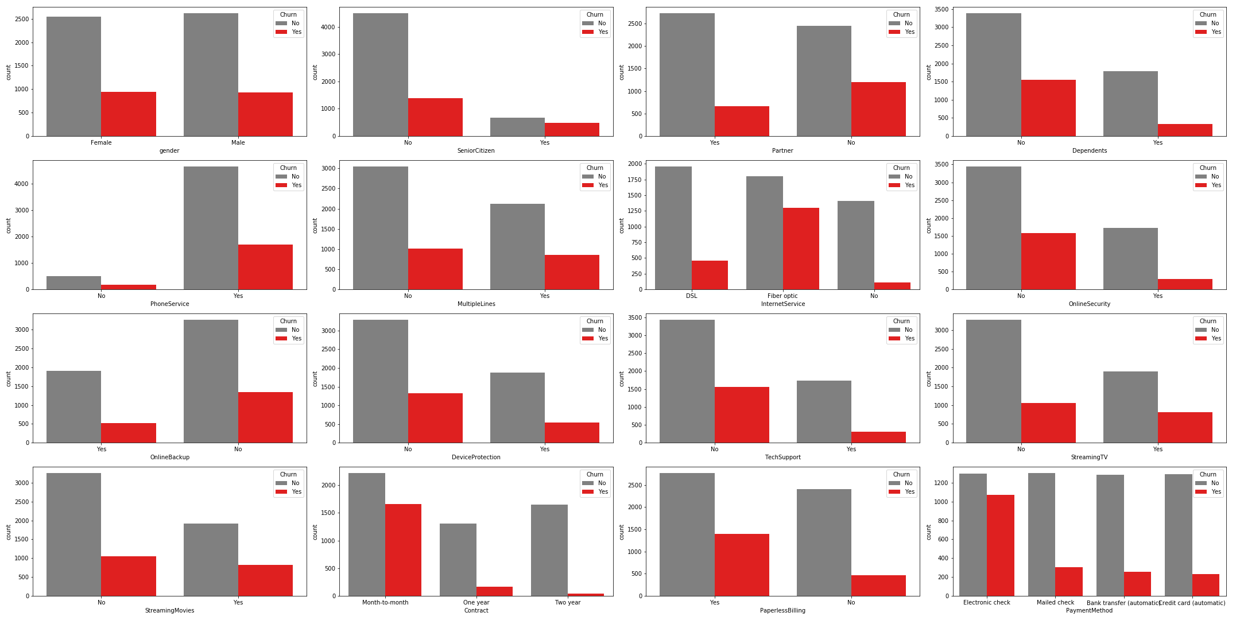
Research Framework
Data Visualization: Categorical Variables with Bar Chart.
Categorical Variables:
The data is represent the distribution of each categorical variables to distinguish between customer tends to churn or stay within the company.
As we can see, in the Payment Method bar chart customers that used Electronic Check has a great tendency to churn rather than the other methods.
For monthly contract customer tends to highly churn rather yearly customer.
And fiber optic service has a trend to quit the service.

Slide 10
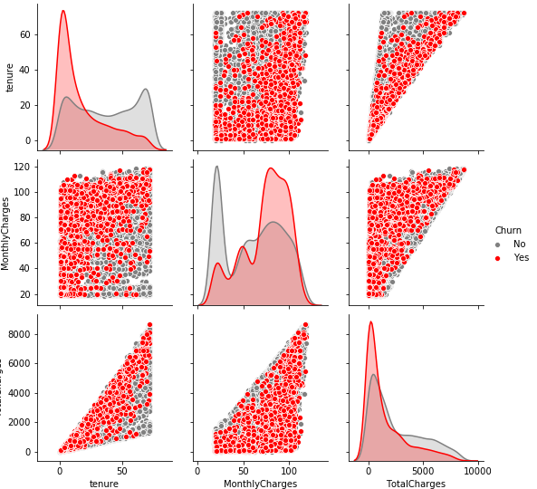
Research Framework
Data Visualization: Categorical Variables with Bar Chart.
Categorical Variables:
The data is represent the distribution of each numerical variables to distinguish between customer tends to churn or stay within the company.
At the tenure and total charges, has a tendency the higher tenure as well as the total charges .
In sharp contrast, at the monthly charges and tenure. Customer who has stayed within the company for a long time and has lower monthly charges tends to not quit from the services.

Slide 11
Thank You
Jakarta, June 2020

